Slide 1
Evolutionary Game Theory & Applications

Slide 2
What is the Game?
‘Games’
Mathematical models of strategic interaction between rational decision-makers.
Player
Strategy
Payoff

Slide 3
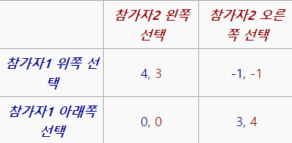
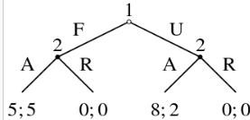


What is the Game? -Expressions
‘Games’
Cooperative
Non-cooperative
$$Determine the payoff using any related functions$$
Characteristic functions
Extensive form or Normal form

Slide 4
Evolutionary Game Theory
studies players who adjust their strategies over time according to rules that are not necessarily rational or farsighted.
‘Games’

Slide 5

Replicator Equation
Current frequency
of strategy
Own fitness relative to the average
“More successful strategies grow faster”

Slide 6
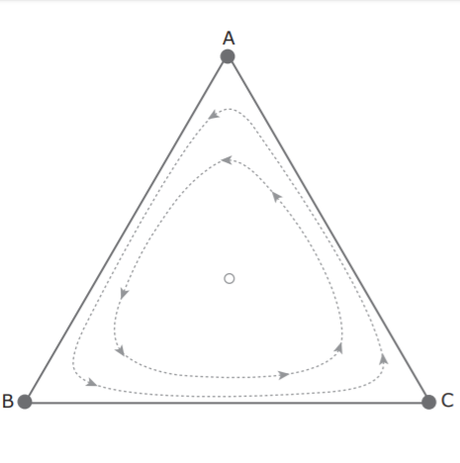

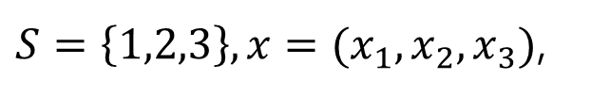








$S=\left\{1,2,3\right\}, x=(x_{1}, x_{2},x_{3})$,
$$x_{P}=1$$
Not asymptotically Stable.
$$replicator dynamics :3$$
$\left(x_{R}, x_{P}\right)=(0.5,0.5)$
$\left(x_{S}, x_{P}\right)=(0.5,0.5)$
 | R | P | S
R | 0 | -1 | 1
P | 1 | 0 | -1
S | -1 | 1 | 0
$\left(x_{R}, x_{P},x_{S}\right)=(0.33,0.33,0.33)$
Starting frequencies:
$x=(0.25,0.25,0.5)$
$$x_{R}=1$$
$\left(x_{R}, x_{S}\right)=(0.5,0.5)$
$$x_{S}=1$$

Slide 7
On $n×n$ lattice ($n=20 or more$)
Will be occupied by the player have the highest pay-off in this round.
neighbor
neighbor
neighbor
neighbor
Player
neighbor
Playing Games
(one time-step)
neighbor
neighbor
neighbor
Given initial conditions :
Cooperator or Defector

Slide 8
ASSUMPTIONS ( T>R>P>S )
Player 1
Cooperator
R
Player 1 or Player 2
Cooperator
S
Player 2
Pay-off
Pay-off
Player 1
Defector
P
Player 1 or Player 2
Defector
T
Player 2
Pay-off
Pay-off

Slide 9
